Slide 1
Chapter Five
Server-Side Programs
Web server Configuration
Common Gateway Interface(CGI)
PHP

Slide 2
Outline
Apache Web Server Configuration
The Common Gateway Interface (CGI)
Introduction to Server-Side Scripts
PHP
Session Controls

Slide 3
Server-Side Programs
How to generate a dynamic content to web pages or web applications?
Solution
Using Server-Side Programs
Common Gateway Interface (CGI)
Using any programming languages
Server-Side Script Languages
php , asp(active server pages, jsp(java server pages) …

Slide 4
Introduction to CGI
In order to deliver dynamic content, we need to extend the abilities of the web server so that it can do more than merely send static web pages in response to client requests. The common gateway interface (CGI) provides a mechanism to do this
Common Gateway Interface
Is a standard environment for web servers to interface with executable programs installed on a server that generate web pages dynamically. Such programs are known as CGI scripts or simply CGIs
A CGI script can be written in any language that allows it to be executed (e.g., C/C++, Fortran, PERL, TCL, Visual Basic, AppleScript, Python, and Unix shells), but by far, the most common language for CGI scripting is PERL, followed by C/C++.

Slide 5
How CGI Works?
When serving static web pages, the server is normally asked for a file that has a .htm or .html extension. If we wish to serve a dynamic page the extension would be different, for example .cgi,
.pl, or .php, .jsp, .asp
If a request comes in with one of these extensions the web server knows to pass the request to the CGI which then interprets it correctly and executes the script in the particular scripting language
Once the script has finished executing the CGI then passes the output back to the web server to be delivered as a response to the client request

Slide 6
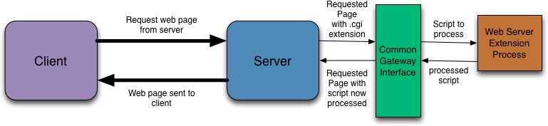
How CGI Works?

Slide 7
Introduction to CGI…
Output of cgi programs could be an html document, image, file …
Most servers expect CGI programs to reside in a special directory, usually called cgi-bin, and/or to have a certain file extension like .cgi, so that the server knows to execute the program rather than simply serving the CGI program as a raw data
CGI programs communicate with the server using STDIN/STDOUT and environment variables

Slide 8
Creating a CGI program
What do we need to create a CGI program?
A programming language
A web server configured for CGI
A web server machine that can execute a program written using the programming language, you used
Write your cgi program in some text editor
Save the executable program with an extension of .cgi in the directory cgi-bin which tells the web server to execute the .cgi program instead before sending it to the client

Slide 9
How to access data send from the client to the server
CGI uses environment variables to send
your program its parameters.
For GET submissions, cgi programs read users form input from the environment variable QUERY_STRING. For POST submissions, from STDIN.

Slide 10
Structure of CGI programs
The first output of a cgi program should be the content type of the response file like
“Content-type: text/html”
On the next line display blank line, to STDOUT
Then start writing your instructions
Everything that should be included in the response HTML page should be printed to STDOUT

Slide 11
CGI program in C example One
#include <stdio.h>
void main() {
cout<<"Content-type: text/html\n\n" ;
/**Print the HTML response page to STDOUT. **/ cout<<"<html>\n" ;
cout<<"<head><title>CGI Output</title></head>\n" ;
cout<<"<body>\n" ;
cout<<"<h1>Hello, world.</h1>\n" ;
cout<<"</body>\n" ; cout<<"</html>\n" ;
exit(0) ;
}

Slide 12
CGI program in C example Two
<form action="http://www.cs.tut.fi/cgi-bin/mult.cgi">
Multiplicand 1: <input type=“text” name="m">
Multiplicand 2: <input type=“text” name="n">
<input type="submit" value="Multiply!“> </form>
#include <stdio.h>
#include <stdlib.h>
int main(void) {
char *data; long m,n;
printf("%s%c%c\n", "Content-Type:text/html;”,13,10); printf("<TITLE>Multiplication results</TITLE>\n"); printf("<H3>Multiplication results</H3>\n");
data = getenv("QUERY_STRING");
printf("<P>The product of %ld and %ld is %ld.",m,n,m*n); return 0; }
mult.cgi

Slide 13
Drawbacks of cgi Programming
The fundamental architectural issue with CGI-BIN based systems is that
Each time a CGI script is executed, a new process is started. For busy Web sites, this can slow down the server noticeably

Slide 14
Server Slide Scripts
Server-side scripting is often used to provide a customized interface for visitors
Run on the server side
Source code is hidden from visitors
Can interact with database and other data sources like file
Examples
PHP, JSP, ASP.net …
Programs written in the above languages don’t require to spawn(generate) a new process every time a page is requested

Slide 15
Introduction to PHP
What is PHP?
PHP is an acronym for "PHP: Hypertext Preprocessor"
PHP is a widely-used, open-source scripting language
PHP is free to download and use
What is a PHP File?
PHP files can contain text, HTML, CSS, JavaScript, and PHP code
PHP code are executed on the server, and the result is returned to the browser as plain HTML
PHP files have extension ".php"

Slide 16
Introduction to PHP cont’d…
What Can PHP Do?
PHP can generate dynamic page content
PHP can create, open, read, write and delete files on the server
PHP can process form data
PHP can send and receive cookies
PHP can add, delete, modify data in your database
PHP can be used to control user-access (Session Management)
PHP can encrypt data
With PHP you are not limited to output HTML. You can output images, PDF files, and even Flash movies. You can also output any text, such as XHTML and XML.

Slide 17
Introduction to PHP cont’d…
Why PHP?
PHP runs on various platforms (Windows, Linux, Unix, Mac OS X, etc.)
PHP is compatible with almost all servers used today (Apache, IIS(Internet Information Service), etc.)
PHP supports a wide range of databases
PHP is free
PHP is easy to learn and runs efficiently on the server side
Setting Up PHP
Install a web server
Install PHP
Install a database, such as MySQL

Slide 18
PHP Example
<html>
<head>
<title> PHP Introduction </title>
</head>
<body>
This is HTML! <br />
This is HTML! <br /> </body>
</html>
Output: resulting HTML
<html>
<head>
<title> PHP Introduction </title>
</head>
<body>
This is HTML! <br />
<?php
echo 'This is PHP! <br />’;
?>
</body>
</html>
PHP file
A PHP script is executed on the server, and
the plain HTML result is sent back to the
browser

Slide 19
Introduction to PHP cont’d…
Basic PHP Syntax
A PHP script can be placed anywhere in the document
A PHP script starts with <?php and ends with ?>:
PHP statements end with a semicolon (;)
Comments
// This is a single-line comment
# This is also a single-line comment
/* multi line comment*/
PHP is case sensitive (variables not PHP keywords, functions, class names, class functions)
PHP is whitespace insensitive

Slide 20
Variables
In PHP, a variable starts with the $ sign, followed by the name of the variable:
$txt = "Hello world!";
$x = 5;
$y = 10.5;
PHP has no command for declaring a variable. It is created the moment you first assign a value to it
Variable name can only contain letter, number or underscore and it cannot start with a number
PHP is a loosely-typed language
Do not need to declare the type of a variable
Type can change throughout the program

Slide 21
PHP Variables Scope
PHP has three different variable scopes:
Global
A variable declared outside a function has a GLOBAL SCOPE and can only be accessed outside a function
The global Keyword
The global keyword is used to access a global variable from within a function.
Local
A variable declared within a function has a LOCAL SCOPE and can
only be accessed within that function
Static
When a function is completed/executed, all of its variables are deleted. However, sometimes we want a local variable NOT to be deleted, Syntax: static $x = 0;

Slide 22
Variables example
<?php
$x = 5; // global scope
function myTest()
{
$y = 5; // local scope
// using x inside this function will generate an error
echo "<p>Variable x inside function is: $x</p>";
}
myTest();
echo "<p>Variable x outside function is: $x</p>";
// using y outside the function will generate an error
echo "<p>Variable y outside function is: $y</p>";
?>

Slide 23
Variables Example: global keyword
<?php
$x = 5;
$y = 10;
function myTest()
{
global $x, $y; // refers to the above variables
$y = $x + $y;
}
myTest();
echo $y; // outputs 15
?>

Slide 24
Variables Example
PHP also stores all global variables in an array called $GLOBALS[index]. The index holds the name of the variable. This array is also accessible from within functions and can be used to update global variables directly.
<?php
$x = 5;
$y = 10;
function myTest() {
$GLOBALS['y'] = $GLOBALS['x'] + $GLOBALS['y’]; }
myTest();
echo $y; // outputs 15
?>

Slide 25
PHP Data Types
Variables can store data of different types.
PHP supports the following data types:
String : can be any text inside quotes. You can use single or double quotes:
Integer : $x=10;
Float (also called double): $x=10.01;
Boolean $x=true;
Array : $cars = array("Volvo","BMW","Toyota");
Object: are instances of programmer-defined classes
NULL: A variable of data type NULL is a variable that has no value assigned to it. $x=null;
var_dump() function can be used to identify the data type and value of a variable
Usage : var_dump($x);

Slide 26
PHP Constants
A constant is an identifier for a simple value. The value cannot be changed during the script.
A valid constant name starts with a letter or underscore (no $ sign before the constant name).
Unlike variables, constants are automatically global across the entire
script.
To create a constant, use the define() function.
Syntax
define(name, value, case-insensitive)
<?php
define("GREETING", "Welcome to W3Schools.com!", true);
echo GREETING;
?>

Slide 27
PHP Operators
PHP divides the operators in the following groups:
Arithmetic operators {+, -, *, /, %, **}
Assignment operators {=, +=, -=, *=, /=, %=}
Comparison operators {==, ===, !=, <>, !==, >,< ..}
Increment/Decrement operators {++, --}
Logical operators {and, or, xor, &&, ||, !}
String operators {. (concatenation) .= (concatenation assignment)}
Array operators {+, ==, ===, !=, <>,!== }

Slide 28
PHP Echo and Print
In PHP there are two basic ways to get output: echo and print
Singly quoted strings are treated literally, whereas doubly quoted strings replace variables with their values
ECHO
has no return value
can take multiple parameters
can be used with or without parentheses:
Faster than print
echo "<h2>PHP is Fun!</h2>";
echo ("Hello world!<br>“);
echo “Hello", “World“;
echo "<h2>$txt1</h2>";
echo "Study PHP at $txt2<br>"; echo $x + $y;
PRINT
has a return value of 1 so it can be used in expressions
can take one argument
can be used with or without parentheses: print or print ().
print "<h2>PHP is Fun!</h2>"; print "Hello world!<br>";
print "<h2>$txt1</h2>";
print ("Study PHP at $txt2<br>“); print $x + $y;

Slide 29
PHP String Functions
Commonly used functions to manipulate strings are
strlen(): returns the length of a string
echo strlen("Hello world!");
str_word_count(): counts the number of words in a string
echo str_word_count("Hello world!");
strrev(): reverses a string
echo strrev("Hello world!");
strpos(): searches for a specific text within a string
echo strpos(" Helloworld!", "world"); // outputs 6
str_replace(): replaces some characters with some other characters in a string
echo str_replace("world", "Dolly", "Hello world!"); // outputs Hello Dolly!

Slide 30
Conditional Statements
PHP have the following conditional statements:
Use if to specify a block of code to be executed, if a specified condition is true
Use else to specify a block of code to be executed, if the same condition is false
Use else if to specify a new condition to test, if the first condition is false
Use switch to specify many alternative blocks of code to be executed

Slide 31
Conditional Statements Example
<?php
$t = date("H");
if ($t < "10")
{
echo "Have a good morning!";
}
elseif ($t < "20") {
echo "Have a good day!";
}
else {
echo "Have a good night!";
}
?>
<?php $favcolor = "red";
switch ($favcolor) {
case "red":
echo "Your favorite color is red!";
break;
case "blue":
echo "Your favorite color is blue!";
break;
case "green":
echo "Your favorite color is green!";
break;
default:
echo "Your favorite color is
neither red, blue, nor green!"; } ?>

Slide 32
PHP Loops
PHP supports different kinds of loops:
for
loops through a block of code a number of times
foreach
loops through elements of an array
while
loops through a block of code while a specified condition is true
do/while
also loops through a block of code while a specified condition is true

Slide 33
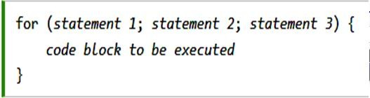
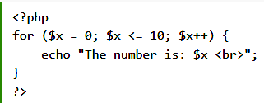
For Loop
The for loop has the following syntax;

Slide 34

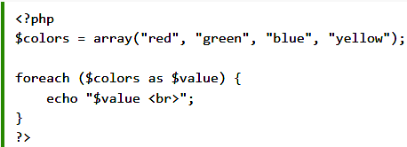
Foreach Loop
Works only on arrays, and is used to loop through each key/value pair in an array.

Slide 35

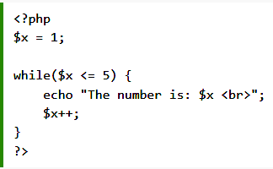
The While Loop
The while loop loops through a block of code as long as a specified condition is true.

Slide 36
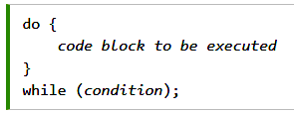
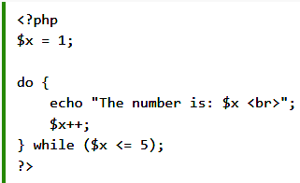
The do/while loop
This loop executes the code block at least once, before checking if the condition is true, then it will repeat the loop as long as the condition is true.

Slide 37
PHP Arrays
In PHP, there are three types of arrays:
Indexed arrays - Arrays with a numeric index
Using array() function
$cars = array("Volvo", "BMW", "Toyota");
On the fly
$cars[0]=“Volvo”; $cars[1]=“BMW”;
Associative arrays - Arrays with named keys
Using array() function
$age = array("Peter"=>"35", "Ben"=>"37", "Joe"=>"43");
On the fly
$age['Peter'] = "35"; $age['Ben'] = "37"; $age['Joe'] = "43";
Multidimensional arrays - Arrays containing one or more arrays
$cars = array (array("Volvo",22,18), array("BMW",15,13));

Slide 38

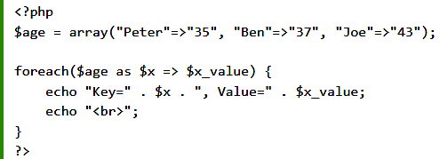
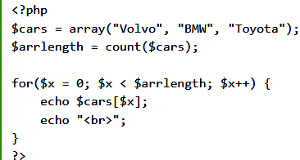
Array Examples
The count() function is used to return the length of an array

Slide 39
Some PHP Array Functions
sort() - sort arrays in ascending order , rsort() - sort arrays in descending order
asort() - sort associative arrays in ascending order, according to the value
array_keys() - returns all the keys of an array
array_multisort() - sorts multiple or multi-dimensional arrays
array_push() - inserts one or more elements to the end of an array
array_reverse() - returns an array in the reverse order
array_search() - searches an array for a given value and returns the key
array_sum() - returns the sum of the values in an array
array_unique() - removes duplicate values from an array
shuffle() - shuffles an array

Slide 40
PHP Functions
Besides the built-in PHP functions, we can create our own functions.
A function will not execute immediately when a page loads. Instead will be executed by a call to the function
Syntax
function functionName(){ code to be executed; }
Function with parameters
function functionName($param1, $param2){ code to be executed; }
Function with default argument
function functionName($param1=5, $param2){ code to be executed; }
Returning values
function functionName(){ code to be executed; return $value; }

Slide 41
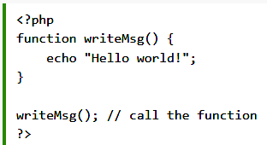
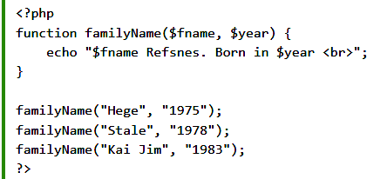
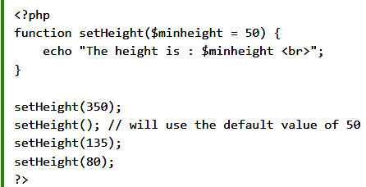

Slide 42
Global Variables - Superglobals
Superglobal variables
are built-in variables that are always available in all scopes,
can be accessed from any function, class or file without having to do anything special
Some of the superglobal variables are:
$GLOBALS : is used to access global variables from anywhere in the PHP script
$_SERVER: holds information about headers, paths, and script locations.
$_REQUEST: is used to collect data after submitting an HTML form.
$_POST, $_GET, $_FILES, $_ENV, $_COOKIE, $_SESSION

Slide 43
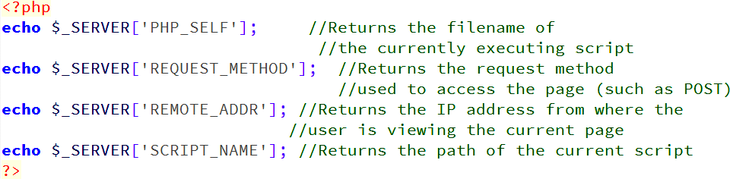
$_SERVER Super global
$_SERVER holds information about headers, paths, and script locations.

Slide 44
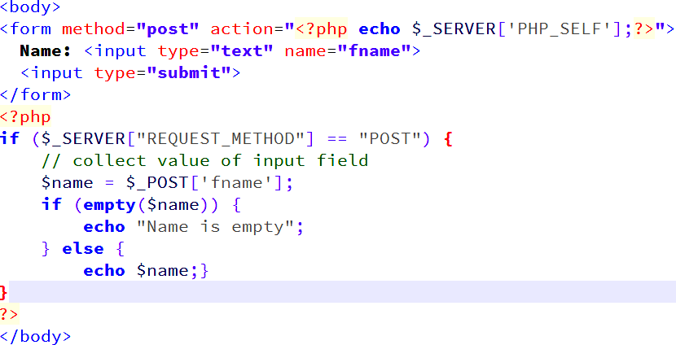
$_POST Super global
$_POST is used to collect form data after submitting an HTML form with method="post”

Slide 45
$_GET Super global
$_GET used to collect form data after submitting an HTML form with method="get“
$_GET can also collect data sent along with a URL
<html>
<body>
<a href=“test_get.php?num1=2&num2=3”> Test $GET </a>
</body>
</html>
<html>
<body>
<? php echo “Product= “. $_GET[‘num1’]*$_GET[‘num2’]; ?>
</body>
</html>
test_get.php

Slide 46
PHP Date and Time
The date() function formats a timestamp to a more readable date and time.
Syntax
date(format,timestamp)
format Required. Specifies the format of the timestamp
d - Represents the day of the month (01 to 31)
m - Represents a month (01 to 12)
Y - Represents a year (in four digits)
l (lowercase 'L') - Represents the day of the week
timestamp Optional.
Specifies a timestamp: which is a sequence of characters, denoting the date and/or time at which a certain event occurred.
Default is the current date and time

Slide 47
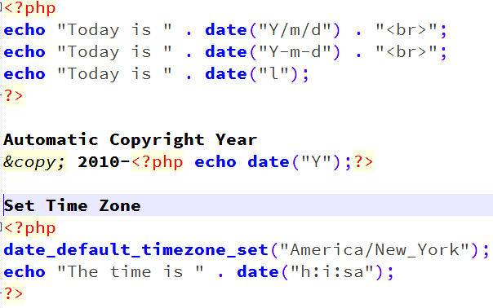
Date Examples

Slide 48
PHP Include Files
PHP Include & Require Statements
are used to insert the content of one PHP file into another PHP file (before the server executes it)
Syntax
include 'filename'; or require 'filename';
The include and require statements are identical, except upon failure:
If a file is not found require will produce a fatal error and stop the script whereas include will only produce a warning and the script will continue
So, if you want the execution to go on and show users the output, even if the include file is missing, use the include statement.

Slide 49
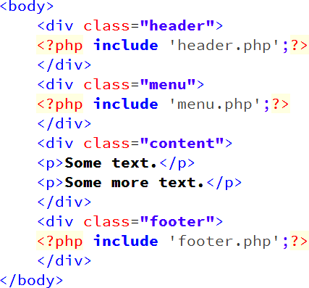
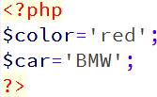
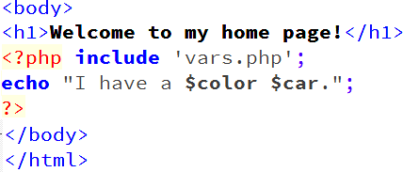
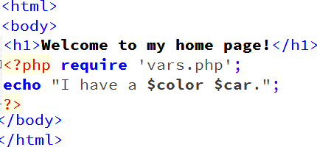
include & require Examples
 | vars. | php

Slide 50
PHP Manipulating Files
PHP has several functions for creating, reading, uploading, and editing files.
fopen(filename, openingMode):
opens a file, on a file that does not exist, it will create it, given that the file is opened for writing (w) or appending (a).
fclose(pointerToOpenedFile):
is used to close an open file
feof(pointerToOpenedFile):
checks if the "end-of-file" (EOF) has been reached

Slide 51
PHP File Opening Modes
r Read only. File pointer at the start of the file
r+ Read/Write. File pointer at the start of the file
w Write only. Overwrites the file
w+ Read/Write. Overwrites the file
a Append. File pointer at the end of the file.
If the file doesn't exist, fopen() will try to create the file
a+ Read/Append. File pointer at the end of the file.
x Create and open for write only.
File pointer at the beginning of the file.
If the file already exists, the fopen() call will fail and generate an error. If the file does not exist, try to create it
x+ Create and open for read/write.
File pointer at the beginning of the file.
If the file already exists, the fopen() call will fail and generate an error.
If the file does not exist, try to create it

Slide 52
PHP Read from File Functions
readfile(filename):
reads a file and writes it to the output buffer
fread(param1, param2): reads from an open file
param1: contains the name of the file to read from
param2: specifies the maximum number of bytes to read
fgets(pointerToOpenedFile)
is used to read a single line from a file
fgetc(pointerToOpenedFile)
is used to read a single character from a file

Slide 53
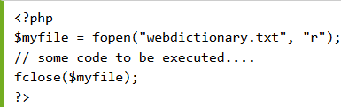

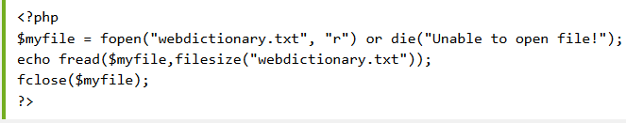
PHP File Manipulation Examples

Slide 54
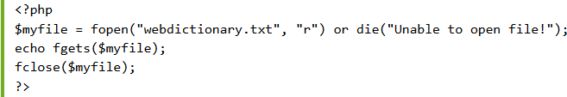
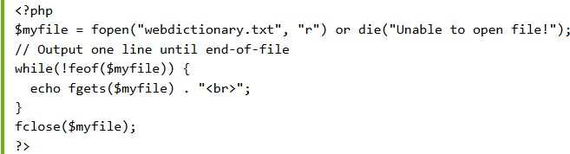
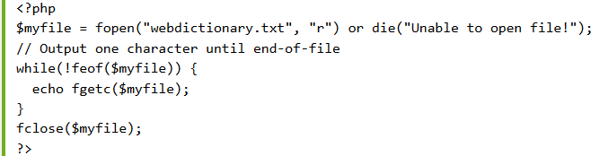
PHP File Manipulation Examples

Slide 55
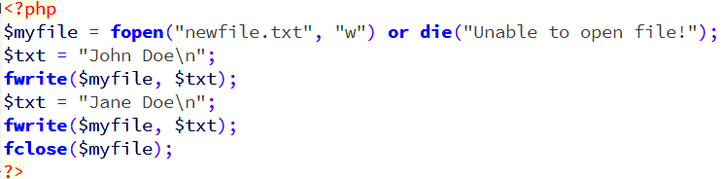
PHP Write to File Functions
fwrite(param1, param2) function is used to write to a file.
param1: contains the name of the file to write to and
param2: is the string to be written

Slide 56
PHP Locking Files
File locking mechanisms
With many users accessing your scripts at the same time, your files could quickly become corrupt.
flock() function
locks a file and won’t allow other processes to write or read the file while the current process is running.
Syntax :
flock(pointerToOpenedFile, lockingMode)
flock($fp1, 1); //shared lock – allows read, doesn’t allow write
flock($fp2, 2); //exclusive lock – doesn’t allow neither read, nor write
flock($fp3, 3); //release lock – releases a shared or exclusive lock

Slide 57
PHP Locking Example
<?php
$file = fopen("test.txt","w+");
// exclusive lock
if (flock($file,LOCK_EX)){
fwrite($file,"Write something");
// release lock flock($file,LOCK_UN);
}
else
{
echo "Error locking file!";
}
fclose($file); ?>

Slide 58
PHP File Manipulation Methods
PHP has a lot of built in functions that you can use with file processing.
Some of them are
“file_exists()”, “is_file()”, “is_dir()”, “is_readable()”,
“is_writeable()”, “is_executable()”;
functions that return information on files:
“filesize()”, “fileatime()”, “filemtime()”, “filectime()”
copy(), delete(), filetype(), fseek(), ftell(), mkdir()

Slide 59
Cookes and Sessions
HTTP is stateless – it does not keep track of the client between requests
But sometimes we need to keep track of this information
Shopping cart
“Remember me” on login sites
2 solutions to this issue
Cookies – small file stored client-side
Sessions – relevant data stored on the server

Slide 60
Cookies
A cookie is a small file that the server stores on the user's computer for tracking purposes.
There are three steps involved in identifying returning users:
Server script sends a set of cookies to the browser.
For example name, age, or identification number etc.
Browser stores this information on local machine for future use.
When next time browser sends any request to web server then it sends those cookies information to the server and server uses that information to identify the user.

Slide 61
Create Cookies with PHP
A cookie is created with the setcookie() function.
Syntax
setcookie(name, value, expire, path, domain, secure);
Only the name parameter is required. All other parameters are optional.
The setcookie() function must appear BEFORE the <html> tag.
The global variable $_COOKIE[] is used to retrieve value of a cookie
Syntax
$_COOKIE[cookieName]
Always check with isset($_COOKIE[$cookie_name]) before
trying to use the cookie’s value

Slide 62
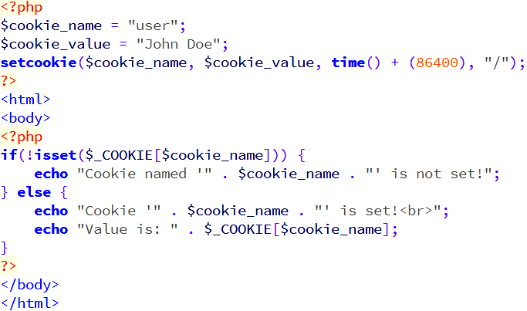
Cookies Example
The example creates a cookie named "user" with the value "John Doe". The cookie will expire after 1 day(86400). The "/" means that the cookie is available in entire website

Slide 63
Setting Cookies
Cookies are usually set in an HTTP header
HTTP/1.1 200 OK
Date: Fri, 04 Feb 2000 21:03:38 GMT
Server: Apache/1.3.9 (UNIX) PHP/4.0b3
Set-Cookie: name=xyz; expires=Friday, 04-Feb-07 22:03:38 GMT; path=/; domain=tutorialspoint.com
Connection: close
Content-Type: text/html
HTTP response message:
From Server to Browser
If a browser is configured to store cookies, it will then keep this information until the expiry date.

Slide 64
Sending Cookies Back to Server
If the user points the browser at any page that matches the path and domain of the cookie, it will resend the cookie to the server. The browser's headers might look something like this:
GET / HTTP/1.0 Connection: Keep-Alive User-Agent: Mozilla/4.6 (X11; I; Linux 2.2.6-15apmac ppc) Host: zink.demon.co.uk:1126
Accept: image/gif, */* Accept-Encoding: gzip Accept-Language: en | HTTP request message: From Browser to Server
Accept-Charset: iso-8859-1,*,utf-8 Cookie: name=xyz

Slide 65
Manipulating cookies cont’d
Modify a Cookie Value
To modify a cookie, just set (again) the cookie using the setcookie() function
Delete a Cookie
To delete a cookie, use the setcookie() function with an expiration date in the past
<?php
// set the expiration date to one hour ago setcookie("user", "", time() - 3600);
?>
Two main disadvantages of cookies
Limited in size by browser
Stored client-side " users / malicious people can change

Slide 66
Sessions
Two main disadvantages of cookies
Limited in size by browser
Stored client-side users / malicious people can change
Sessions store user data on the server
Limited only by server space
Cannot be modified by users
A potential downside to sessions is that they expire when
the browser is closed
Sessions are identified by a session id: often a small cookie! But the rest of the data is still stored on the server

Slide 67
Sessions cont’d
An alternative way to make data accessible across the various
pages of an entire website is to use a PHP Session
A session creates a file in a temporary directory on the server where registered session variables and their values are stored.
This data will be available to all pages on the site during that visit.
The location of the temporary file is determined by a setting in
the php.ini file called session.save_path.

Slide 68
Sessions cont’d
When a session is started, the following actions take place:
PHP first creates a unique identifier for that particular session which is a random string of 32 hexadecimal numbers such as 3c7foj34c3jj973hjkop2fc937e3443.
A cookie called PHPSESSID is automatically sent to the user's computer to store unique session identification string.
A file is automatically created on the server in the designated temporary directory and bears the name of the unique identifier prefixed by sess_ ie sess_3c7foj34c3jj973hjkop2fc937e3443.

Slide 69
Starting a Session
<?php
// Start the session session_start();
?>
<!DOCTYPE html>
<html>
<body
<?php
// Set session variables
$_SESSION["favcolor"] = "green";
$_SESSION["favanimal"] = "cat"; echo "Session variables are set.";
echo $_SESSION["favcolor"];
?>
</body>
</html>
session_start() is used to create or resume a session
The session_start() function must be the very first thing in your document. Before any HTML tags
Session variables are set with the PHP global variable
$_SESSION
All session variable values are stored in the global
$_SESSION variable

Slide 70
Destroy a PHP Session
To remove all
global
session variables and destroy a session, use session_unset() and session_destroy()
<?php session_start(); ?>
<!DOCTYPE html>
<html>
<body>
<?php
// remove all session variables session_unset();
// destroy the session session_destroy();
?>
</body>
</html>

Slide 71
Cookies vs Sessions
 | Cookies | Sessions
Where is data stored? | Locally on client | Remotely on server
Expiration? | Variable – determined when cookie is set | Session is destroyed when the browser is closed
Size limit? | Depends on browser | Depends only on server (practically no size limit)
Accessing information? | $_COOKIE | $_SESSION
General use? | Remember small things about the user, such as login name. Remember things after re-opening browser | Remembering varying amount of data about the user in one browsing “session”. More sensitive info.

Slide 72
PHP Header() Function
The header() function sends a raw HTTP header to a client.
header() must be called before any actual output is sent to the client
Syntax
header(string, replace, http_response_code)
string Required. Specifies the header string to send
replace Optional. Indicates whether the header should replace previous or add a second header. Default is TRUE (will replace). FALSE (allows multiple headers of the same type)
http_response_code Optional. Forces the HTTP response code to the specified value

Slide 73
PHP Header() Function Cont’d
Prevent page caching:
Redirect browser to another page
<?php
// Date in the past
header("Expires: Mon, 26 Jul 1997 05:00:00 GMT"); header("Cache-Control: no-cache"); header("Pragma: no-cache"); ?>
<html>
<body>
…
<?php
header("Location: http://www.w3schools.com/"); ?>
<html> <body> ...... </body> </html>

Slide 74
ERROR AND EXCEPTION HANDLING
The default error handling in PHP is very simple. An error message with filename, line number and a message describing the error is sent to the browser.
Error handling methods:
Simple "die()" statements
Custom errors and error triggers
Error reporting

Slide 75
Basic Error Handling
The die() function prints a message and exits the current script
Syntax
die(message)
<?php if(!file_exists("welcome.txt"))
{
die("File not found");
} else {
$file=fopen("welcome.txt","r");
}
?>

Slide 76
EXCEPTION HANDLING
Proper exception code should include:
Try - A function using an exception should be in a "try" block. If the exception does not trigger, the code will continue as normal. However, if the exception triggers, an exception is "thrown"
Throw - This is how you trigger an exception. Each "throw" must have at least one "catch"
Catch - A "catch" block retrieves an exception and creates an object containing the exception information

Slide 77
EXCEPTION HANDLING Example
<?php
function checkNum($number) {
if($number>1) {
throw new Exception("Value must be 1 or below");
}
return true;
}
try {
checkNum(2);
}
catch(Exception $e) {
echo 'Message: ' .$e->getMessage();
}
?>

Slide 78
Introduction to Object Oriented PHP

Slide 79
Object Oriented Concepts
Class: This is a programmer-defined datatype, which includes local functions as well as local data. You can think of a class as a template for making many instances of the same kind (or class) of object.
Object: An individual instance of the data structure defined by a class. You define a class once and then make many objects that belong to it. Objects are also known as instance.
Member Variable: These are the variables defined inside a class. This data will be invisible to the outside of the class and can be accessed via member functions. These variables are called attribute of the object once an object is created.
Member function: These are the function defined inside a class and are used to access object data.

Slide 80
Object Oriented Concepts Cont’d
Inheritance: When a class is defined by inheriting existing function of a parent class then it is called inheritance. Here child class will inherit all or few member functions and variables of a parent class.
Parent class: A class that is inherited from by another class. This is also called a base class or super class.
Child Class: A class that inherits from another class. This is also called a subclass or derived class.
Polymorphism: This is an object-oriented concept where the same function can be used for different purposes. For example, function name will remain same but it make take different number of arguments and can-do different task.

Slide 81
Object Oriented Concepts Cont’d
Overloading: a type of polymorphism in which some or all of operators have different implementations depending on the types of their arguments. Similarly, functions can also be overloaded with different implementation.
Data Abstraction: Any representation of data in which the implementation details are hidden (abstracted).
Encapsulation: refers to a concept where we encapsulate all the data and member functions together to form an object.
Constructor: refers to a special type of function which will be called automatically whenever there is an object formation from a class.
Destructors: refers to a special type of function which will be called automatically whenever an object is deleted or goes out of scope.

Slide 82
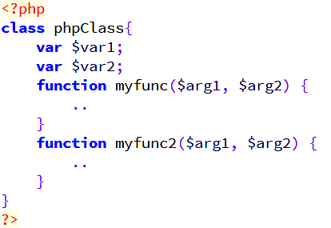
Defining PHP Classes
The general form for defining a new class in PHP is

Slide 83
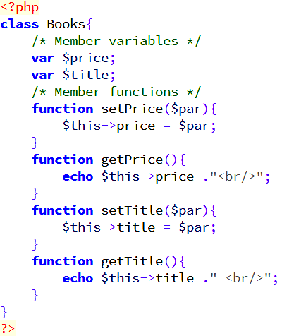
Setter & Getter Methods
The variable $this is a special variable and it refers to the same object, i.e., itself.
-> operator is equal to java’s . operator

Slide 84
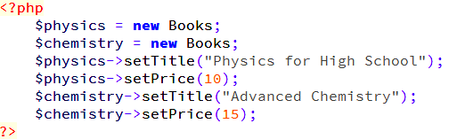
Creating Objects in PHP
Once you defined your class, then you can create as many objects as you like of that class type.
Creating an object using new operator

Slide 85
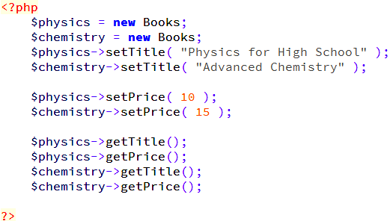
Calling Member Functions
After creating your objects, you will be able to call member functions related to that object.

Slide 86
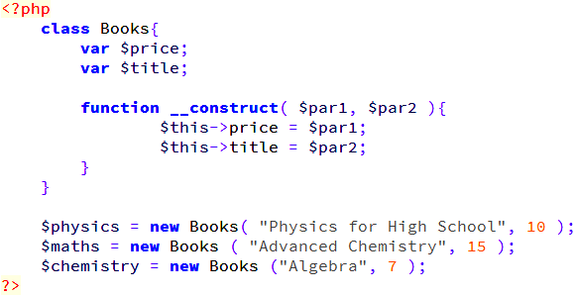
PHP Object Constructors
PHP provides a special function called construct() to define a constructor/object creator.

Slide 87
PHP Object Destructor
Like a constructor function you can define a destructor function using function destruct(). You can release all the resources with-in a destructor.

Slide 88

Inheritance
PHP class definitions can optionally inherit from a parent class definition by using the extends clause. The syntax is as follows:
The effect of inheritance is that the child class automatically inherits:
– All member variables and functions of the parent class

Slide 89
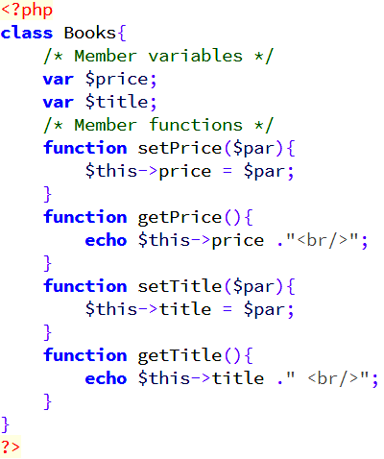
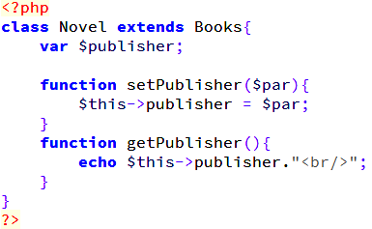
PHP Inheritance Example
Example
The following Novel class inherits Books class and adds more functionality based on the requirement.

Slide 90
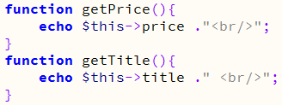
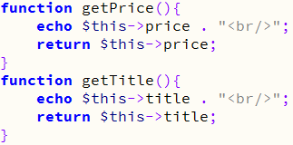
Function Overriding
Function definitions in child classes can override definitions of functions with the same name in parent classes. In a child class, we can modify the definition of a function inherited from parent class.
In the Parent Class
In the Child Class

Slide 91
Member Variables
Public Members
Unless you specify otherwise, properties and methods of a class are public. That is to say, they may be accessed in three possible situations:
From outside the class in which it is declared
From within the class in which it is declared
From within another class that implements the class in which it is declared
If you wish to limit the accessibility of the members of a class then you define class members as private or protected

Slide 92
Member Variables Cont’d
Private Member
By designating a member private, you limit its accessibility to the class in which it is declared.
A private member cannot be referred from classes that inherit the class and cannot be accessed from outside the class.
A class member can be made private by using private keyword

Slide 93
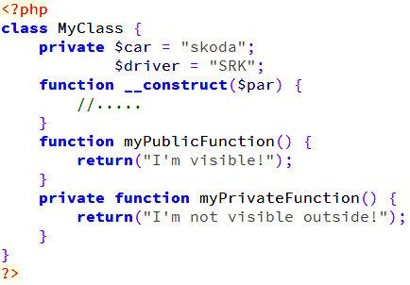
Private Members Example
When MyClass class is inherited by another class using extends, myPublicFunction() will be visible, as will $driver. The extending class will not have any awareness of or access to myPrivateFunction and $car, because they are declared private.

Slide 94
Member Variables Cont’d
Protected Members
A protected property or method is accessible in the class in which it is declared, as well as in classes that extend that class.
Protected members are not available outside of those two kinds of classes.
A class member can be made protected by using protected keyword in front of the member.

Slide 95
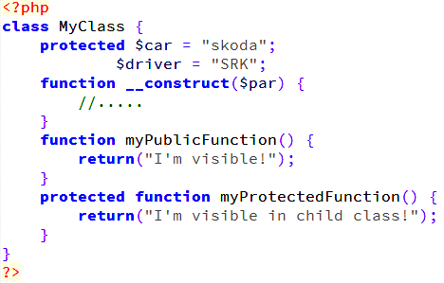
Protected Members Example

Slide 96
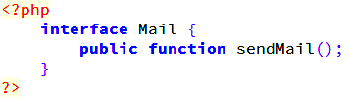
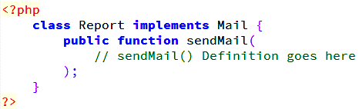
Interfaces
Interfaces are skeletons which are implemented by developers
Syntax to create an interface class
Then, another class can implement the interface, like this:

Slide 97
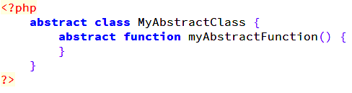
Abstract Classes
An abstract class is one that cannot be instantiated, only inherited. You declare an abstract class with the keyword abstract, like this:
When inheriting from an abstract class, all methods marked abstract in the parent's class declaration must be defined by the child
Note that the function definitions inside an abstract class must also be preceded by the keyword abstract. It is not legal to have abstract function definitions inside a non-abstract class.

Slide 98
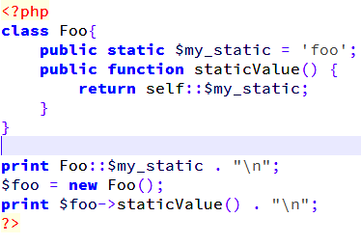
Static Keyword
Declaring class members or methods as static makes them accessible without needing an instantiation of the class.
A member declared as static cannot be accessed with an instantiated class object (though a static method can).

Slide 99
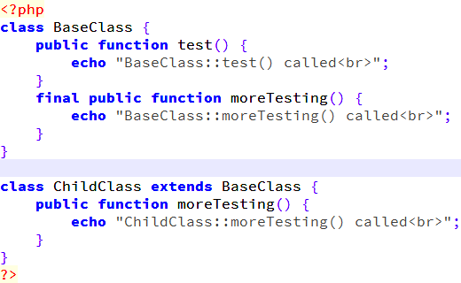
Final Keyword
The final keyword, which prevents child classes from overriding a method by prefixing the definition with final.
If the class itself is being defined final then it cannot be extended.
Following example results in Fatal error: Cannot override final method BaseClass::moreTesting()

Slide 100
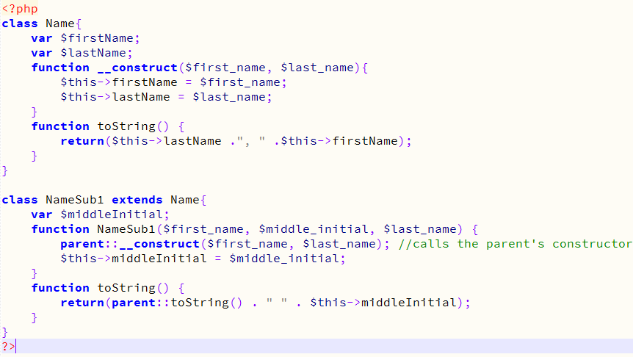
Calling Parent Constructors

Slide 101
P

Slide 102
P

